Slide 1
RISK Management
SurendraKC

Slide 2

Risk

Slide 3
It’s better to hunt for risks before they hunt you
If you don’t proactively identify and manage risks in your project, those risks will eventually appear on their own and likely cause bigger problems.
Be proactive, not reactive.
If you don’t look for potential problems early (like delays, cost overruns, resource issues, or scope changes), they’ll still happen, but you’ll be unprepared.
By identifying risks early, you can plan responses and reduce their impact.
Example:
If a project manager doesn’t check whether a supplier can deliver materials on time (a possible risk), and the supplier later fails to deliver, the whole project may get delayed.
But if the risk had been identified early, the team could have arranged a backup supplier avoiding the problem.

Slide 4
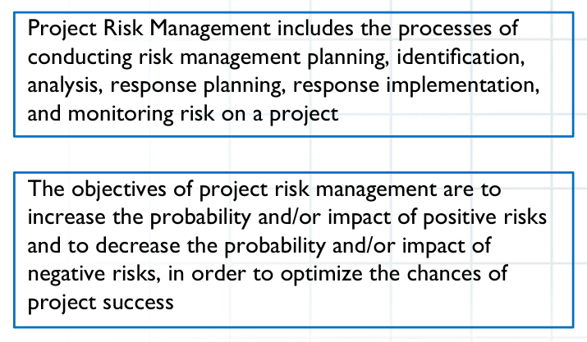
Project Risk Management

Slide 5
Project Risk Management
Project Risk Management is the process of identifying, analyzing, and responding to uncertainty that can have a positive or negative effect on one or more project objectives (such as scope, schedule, cost, or quality)
It’s about finding what could go wrong (threats) or what could go right (opportunities) in a project and planning actions to reduce the bad and increase the good.
The goal of risk management is to:
Minimize negative risks (threats)
Maximize positive risks (opportunities)
Increase the likelihood of project success

Slide 6
Key Concepts of Risk Management
Threats vs Opportunities
Risk Appetite, Tolerance & Threshold
Risk appetite:
The overall willingness to take risk for potential reward.
A startup company may accept high financial risk to achieve big growth.
Risk Tolerance
The range of variation allowed before action is needed.
A project can accept up to 5% cost overrun without worry that’s its tolerance.
Risk Threshold
The exact point beyond which risk is no longer acceptable.
If project cost exceeds 5%, management must take action that’s the threshold.
Residual Risk
The leftover risk after you take action to reduce it.
You install a fire alarm (mitigation), but there’s still a small chance of fire — that remaining chance is residual risk.
Secondary Risk
A new risk created because of your action to fix another risk.
You install a fire sprinkler system, but now there’s a risk of water damage — that’s a secondary risk.

Slide 7
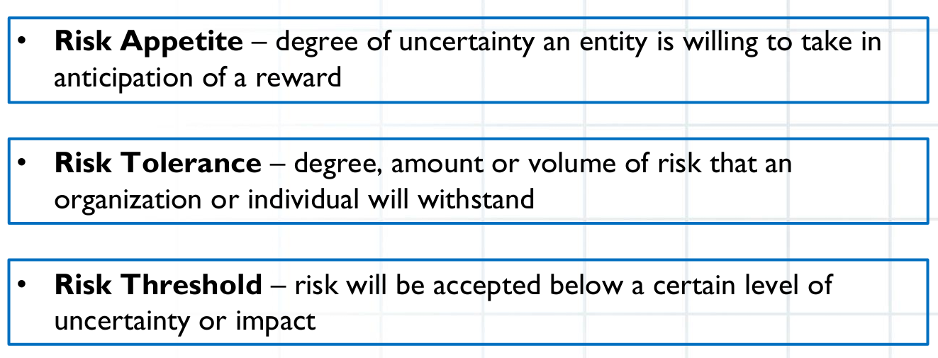

Slide 8
Threat vs Opportunities
Negative Risk (Threat):
An uncertain event that, if it occurs, will have a harmful or adverse effect on project objectives (like delay, cost overrun, poor quality).
Nature: Unfavorable
Goal: Reduce probability or impact
Examples:
Heavy rainfall may delay concrete work.
Key developer resigns in the middle of development.
Power failure during an event causes disruptions.
Regulatory changes delay project approval.
Positive Risk (Opportunity)
An uncertain event that, if it occurs, will have a beneficial or favorable effect on project objectives (like cost saving, faster delivery).
Nature: Favorable
Goal: Increase probability or impact
Examples
Early delivery of materials may help complete work before schedule.
New automation tool reduces testing time by 30%.
New government policy supports faster project approval.

Slide 9
Known vs Un-known Risk
Known Risks (Known–Unknowns)
These are the risks you are aware of — you can identify and plan for them in advance. They are “known–unknowns” because you know they exist, but you don’t know exactly when or how they will occur.
You can analyze, plan a response, and monitor them.
You know rainy season may delay construction, but you don’t know the exact days.
You know a server might crash once in a while, so you set up backups.
You know key staff might leave, so you plan cross-training.
Unknown Risks (Unknown–Unknowns)
These are risks that you cannot predict or identify in advance. They are unexpected events that catch the project by surprise.
Since you can’t plan for them directly, you prepare a contingency reserve or management reserve to handle them.
Sudden earthquake damages the project site.
Pandemic (like COVID-19) disrupts all project work.
New government law bans an essential raw material overnight.

Slide 10
Risk Adverse
Risk averse describes a person or organization’s attitude toward taking risks.
A risk-averse stakeholder prefers safety and predictability — they try to avoid or minimize risk as much as possible.
They often choose low-risk, steady outcomes even if it means smaller rewards.
A company rejects a new technology because it’s untested (too risky).
A project manager insists on thorough testing before release, even if it delays delivery.
An investor prefers fixed deposits over stock market investments.
Known risks → You can see and prepare for them.
Unknown risks → You don’t see them coming, so you keep a backup reserve.
Risk averse → You avoid risk whenever possible.

Slide 11
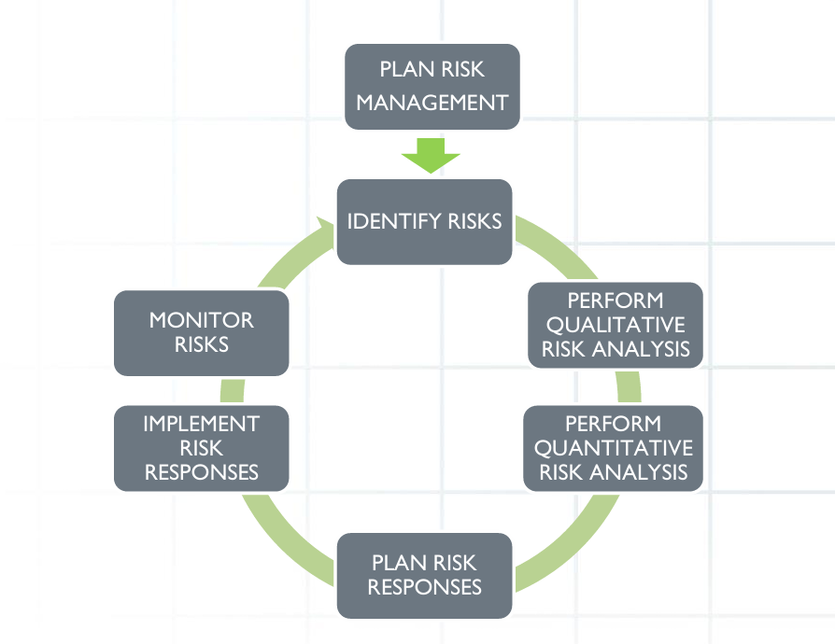
Project Risk Management Steps

Slide 12
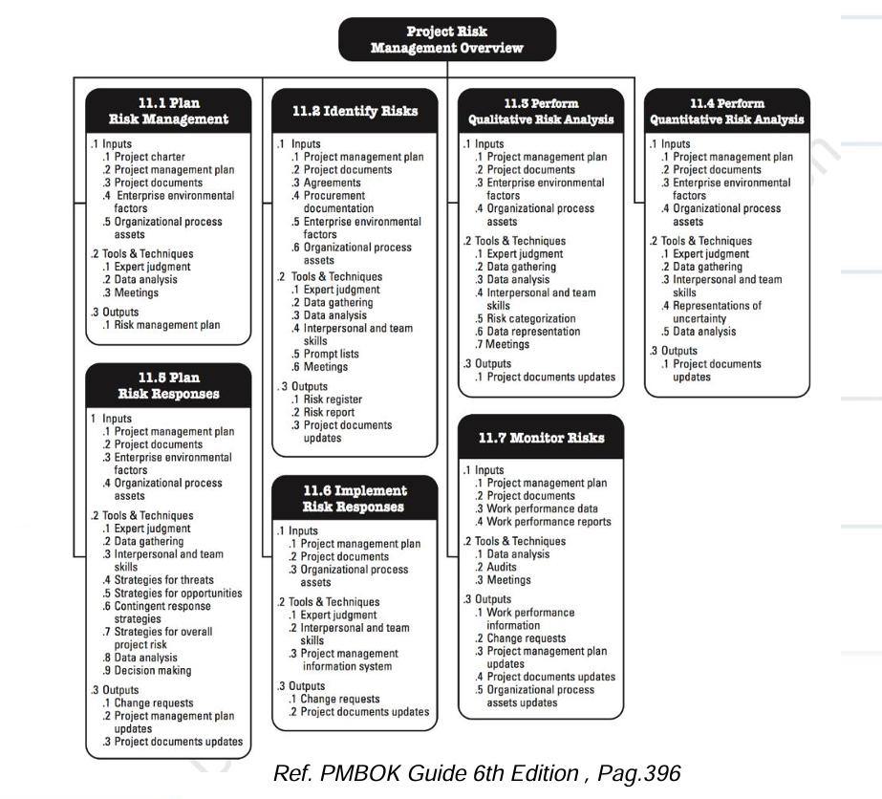

Slide 13
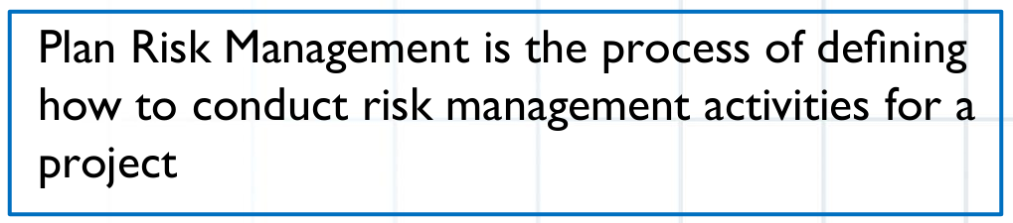
Plan Risk Management
Decide how you will manage risks in your project.
It’s like creating a “rulebook” for risk management who will do what, when, and how.
Review project documents and goals.
Decide methods and tools to identify, analyze, and monitor risks.
Create a Risk Management Plan.
In a software project, the project manager decides that the team will:
Identify risks during weekly meetings,
Use a “Risk Register” to record risks,
Review risks in every sprint.

Slide 14
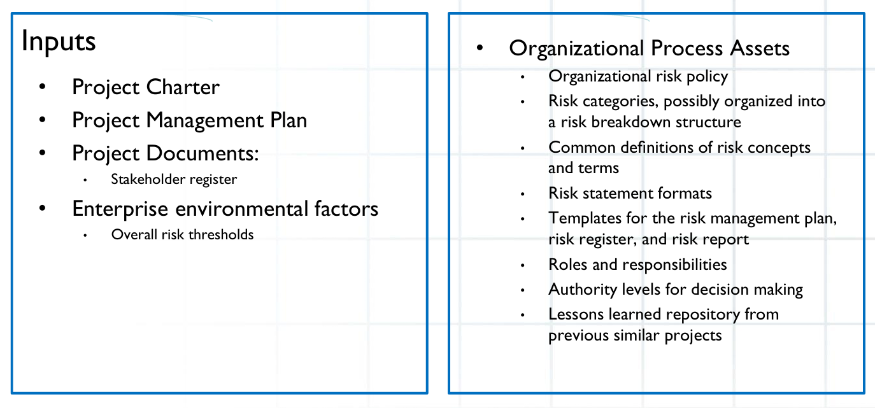
Plan Risk Management

Slide 15
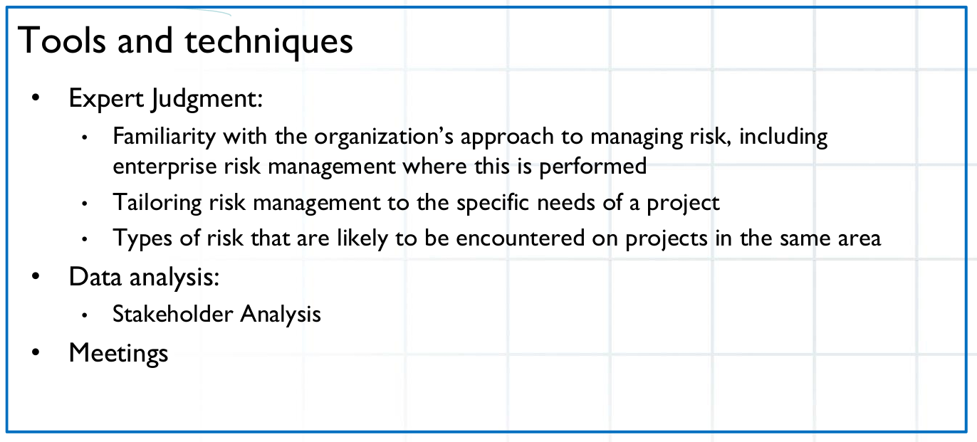
Plan Risk Management

Slide 16
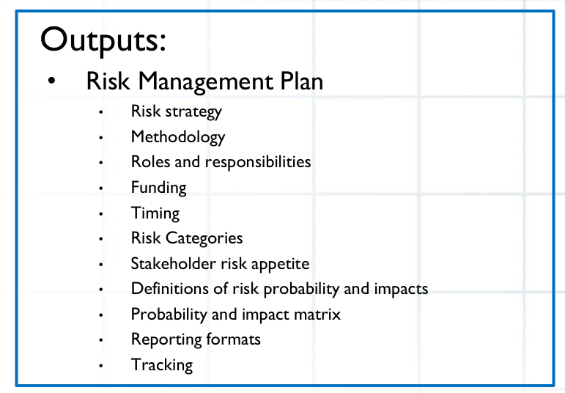
Plan Risk Management

Slide 17
Risk Breakdown Structure
A Risk Breakdown Structure (RBS) is a hierarchical representation of project risks, arranged by categories and subcategories, showing the sources from which risks may arise.
It helps project teams to systematically identify, categorize, and manage risks throughout the project lifecycle.
RBS is like a family tree of risks — showing where risks come from and how they are related.
Purpose of RBS
To ensure no potential risk source is missed.
To organize risks for better understanding and reporting.
To help in risk identification, analysis, and response planning.
To prioritize risks by categories (e.g., technical, external, organizational).

Slide 18
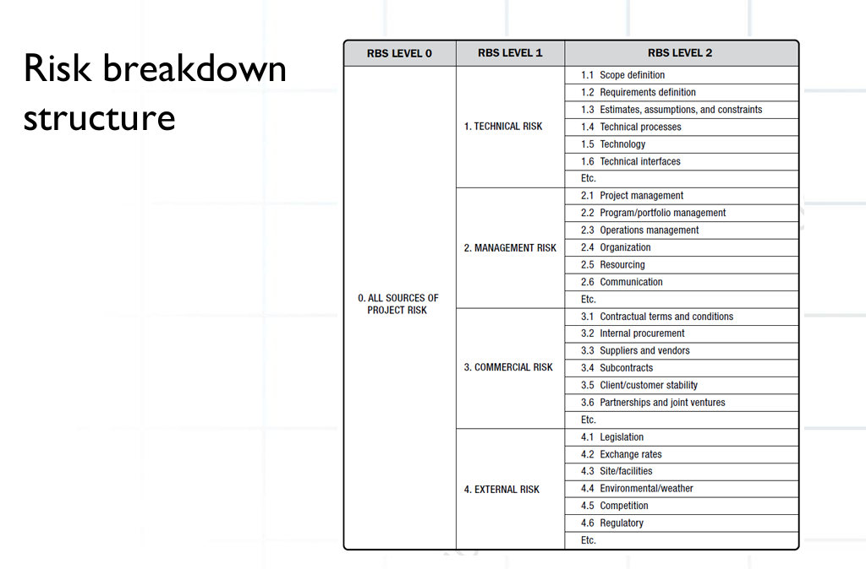
RBS

Slide 19
RBS
1. Technical Risks
1.1 Requirements Risks
- Incomplete requirements
- Changing user needs
1.2 Technology Risks
- New/unproven technology
- Integration issues
1.3 Quality Risks
- Insufficient testing
- Defect leakage

Slide 20
RBS
2. Project Management Risks
2.1 Schedule Risks
- Unclear timeline
- Unrealistic deadlines
2.2 Cost Risks
- Budget overrun
- Scope creep
2.3 Resource Risks
- Key staff leaving
- Inadequate team skills

Slide 21
RBS
3. Organizational Risks
3.1 Stakeholder Risks
- Conflicting interests
- Lack of stakeholder engagement
3.2 Communication Risks
- Miscommunication
- Delayed feedback

Slide 22
RBS
4. External Risks
4.1 Regulatory Risks
- Change in government regulations
4.2 Environmental Risks
- Natural disasters
4.3 Market Risks
- Competitor innovation
- Customer preference change

Slide 23
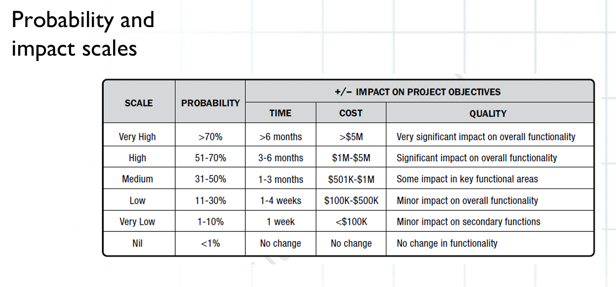
Probability and Impact

Slide 24
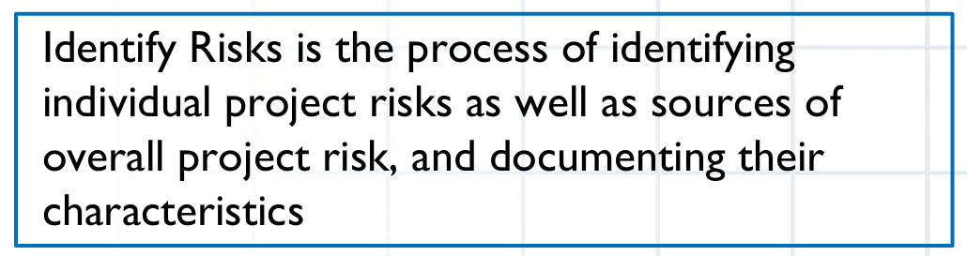
Identify Risks
Risk identification is the process of determining which risks may affect the project and documenting their characteristics.
Includes threats (negative risks) and opportunities (positive risks).
Helps ensure the project team understands uncertainties early and can plan responses proactively.
Objectives of Risk Identification
Detect potential events or conditions that can impact project objectives (scope, schedule, cost, quality, benefits).
Document the risks in a Risk Register (or similar log).
Identify causes and triggers for each risk.
Ensure risks are shared with stakeholders for awareness and accountability.

Slide 25
Identify Risks
Key Inputs
Project Charter & Project Management Plan – for context and assumptions.
Assumptions and constraints – potential sources of uncertainty.
Historical information / Lessons learned – from previous projects.
Stakeholder inputs – experience and insights.
Environmental factors – market, regulatory, technological, cultural factors.

Slide 26
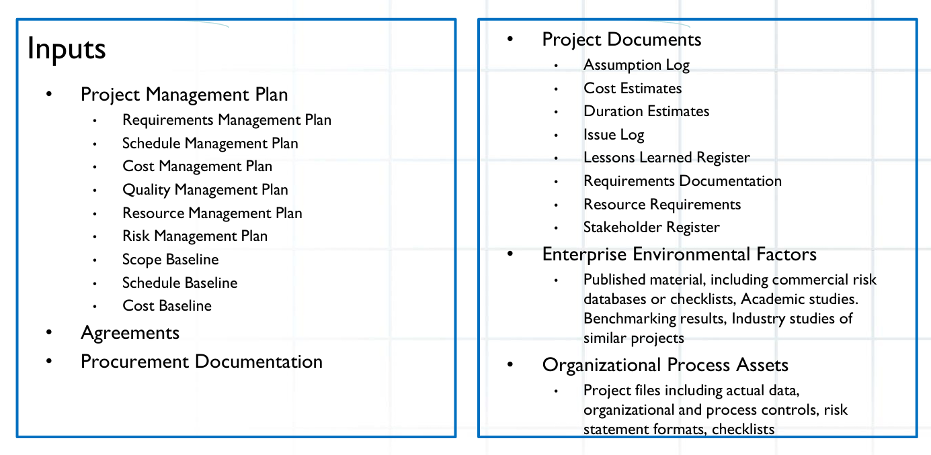
Identify Risks

Slide 27
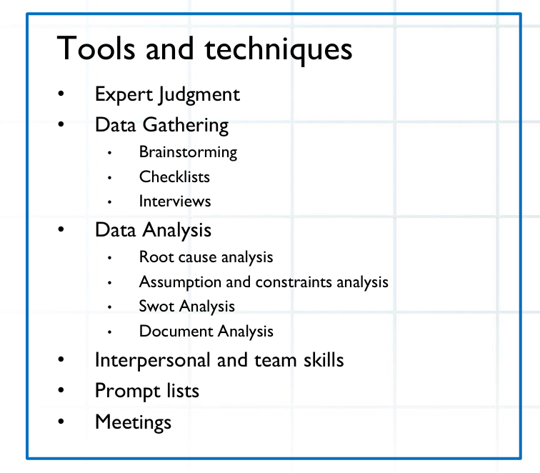
Identify Risks

Slide 28
Identify Risks
Delphi technique
A request for information is sent to all experts, their responses are compiled, and the results are sent back to them for further review until consensus is reached
SWOT analysis
This analysis identifies the project’s strengths and weaknesses (internal) as well as opportunities and threats (external)
Checklist analysis
Based on historical information
The lowest level of RBS(risk breakdown structure) can also be used as a risk checklist
The checklist is used to help identify specific risks within each category
Assumptions analysis
Analyzing what assumptions have been made on the project may lead to the identification of risks
Diagramming techniques
Cause and effect diagrams (Ishikawa )
System or process flow charts
Influence diagrams

Slide 29
Identify Risks
SWOT Analysis for Risk Identification
SWOT stands for:
S – Strengths
W – Weaknesses
O – Opportunities
T – Threats
SWOT is a structured brainstorming tool that helps project teams identify risks (both negative and positive) by analyzing internal and external factors.

Slide 30
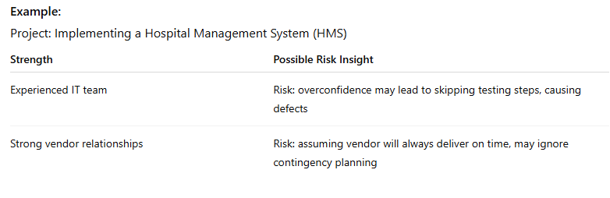
Identify Risks
1. Strengths (S)
Internal factors that help achieve project objectives.
Usually considered positive, but in risk context, over-reliance on strengths can create complacency risks.

Slide 31
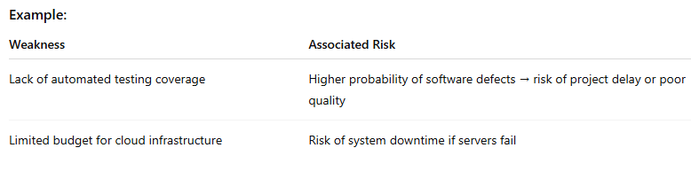
Identify Risks
2. Weaknesses (W)
Internal limitations that can negatively impact objectives.
Weaknesses are often direct sources of threats.

Slide 32
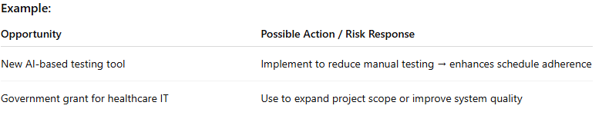
Identify Risks
3. Opportunities (O)
External conditions that could be leveraged to improve project outcomes.
Opportunities are positive risks — you may want to exploit or enhance them.

Slide 33
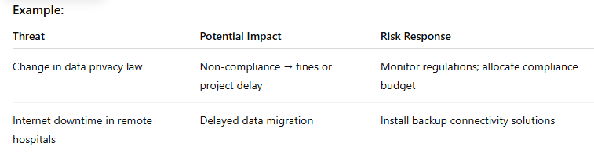
Identify Risks
4. Threats (T)
External conditions that could negatively affect the project.
Threats are negative risks and require avoid, mitigate, transfer, or accept strategies.

Slide 34
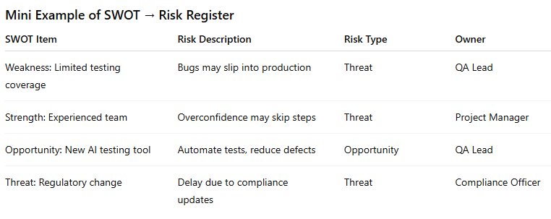
How to Use SWOT in Risk Identification
Gather a team of stakeholders, project members, and subject matter experts.
Brainstorm and list items under each SWOT category.
Translate each item into risks:
Weakness → threat risk
Strength → residual risk if mismanaged
Opportunity → positive risk
Threat → negative risk
Document in Risk Register with category, owner, triggers, and potential impact.

Slide 35
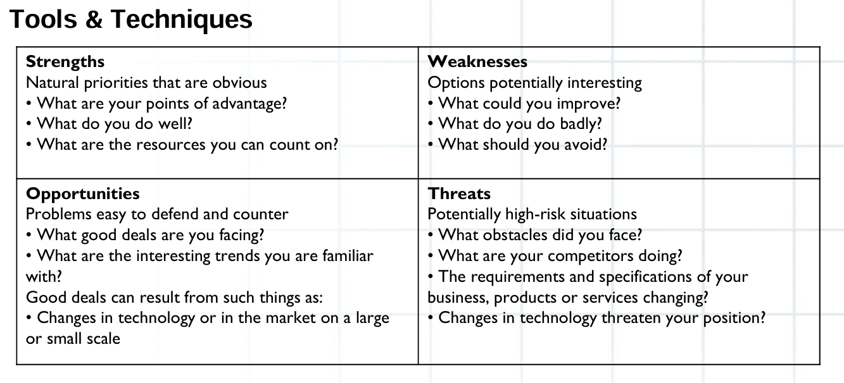
SWOT

Slide 36
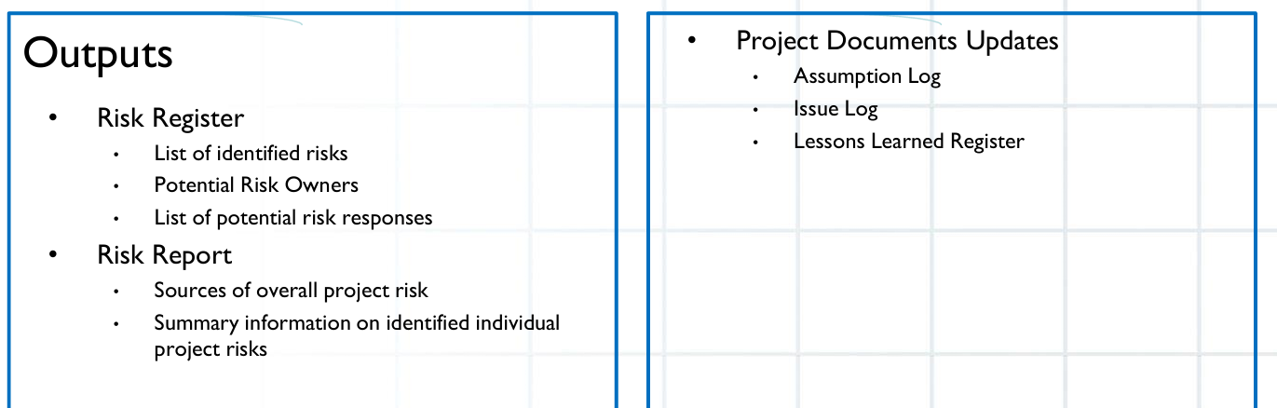
Identify Risks

Slide 37
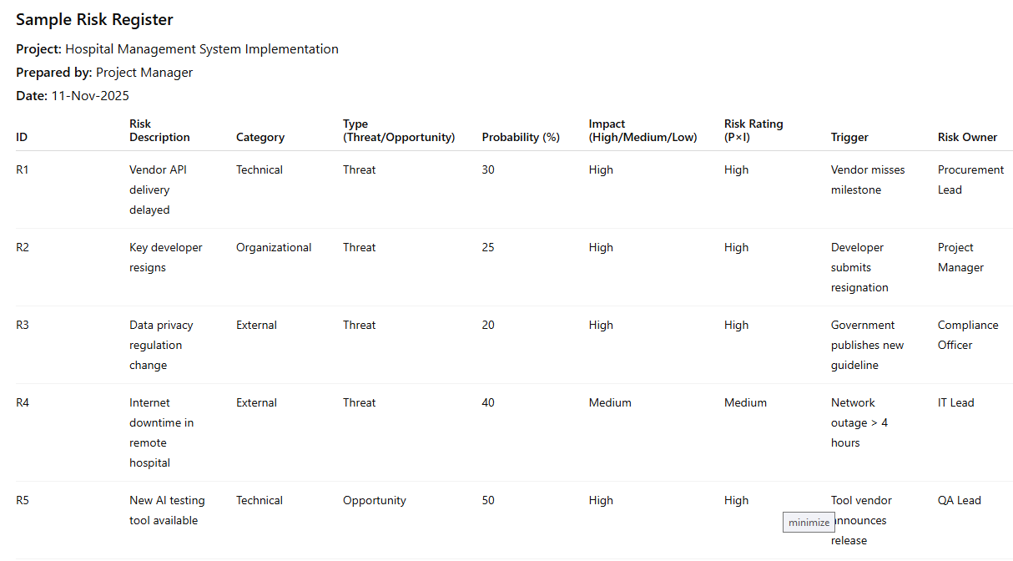
Risk Register sample

Slide 38
Risk Register
ID – Unique identifier for each risk.
Risk Description – Clear statement of the risk.
Category – Technical, Organizational, External, Project Management, etc.
Type – Threat (negative) or Opportunity (positive).
Probability (%) – Likelihood the risk occurs.
Impact – Severity of the risk if it occurs (High/Medium/Low).
Risk Rating (P×I) – Combined measure of risk (qualitative).
Trigger – Event or condition that signals the risk may happen.
Risk Owner – Responsible person for monitoring and managing the risk.
Response Strategy – Action planned (Avoid, Mitigate, Transfer, Accept for threats; Exploit, Enhance, Share, Accept for opportunities).
Residual Risk / Notes – Remaining risk after response, or any additional remarks.

Slide 39
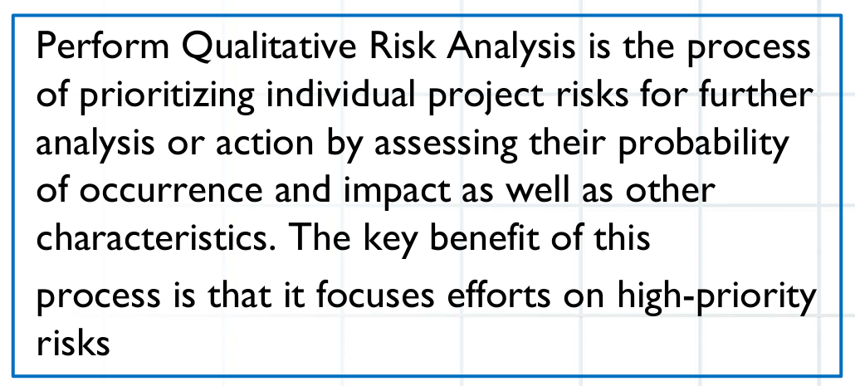
Perform Qualitative Risk Analysis
Perform Qualitative Risk Analysis is the process of prioritizing identified risks based on their likelihood of happening (probability) and impact on project objectives (cost, schedule, quality, scope, benefits).
Purpose / Why It’s Important
Not all risks are equally important.
Helps decide which risks need immediate attention.
Saves time and resources by focusing on high-priority risks.
Supports planning risk responses efficiently.
Inputs for Qualitative Risk Analysis
Risk Register – List of risks identified with basic info.
Project Management Plan – Information about objectives, constraints, assumptions.
Risk Breakdown Structure (RBS) – Helps categorize risks.
Organizational Risk Tolerance / Stakeholder Risk Appetite – Guides prioritization.

Slide 40
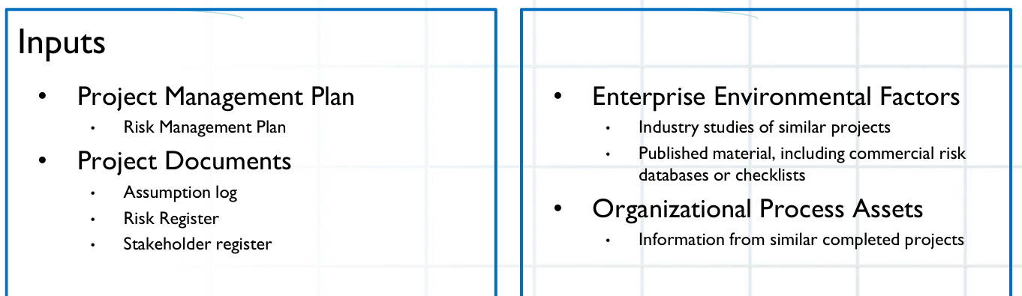
Perform Qualitative Risk Analysis

Slide 41
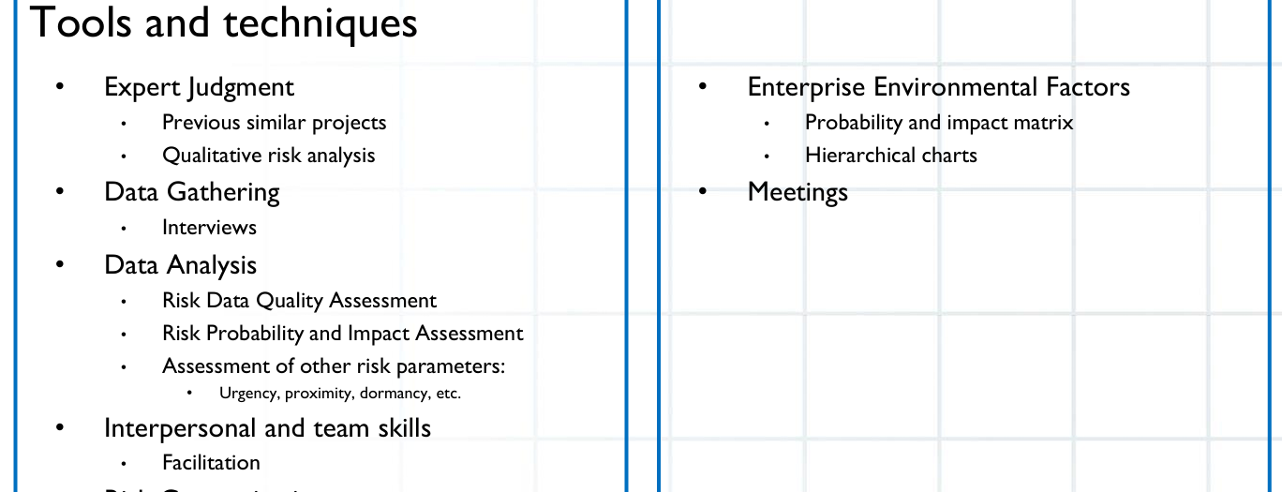
Perform Qualitative Risk Analysis

Slide 42
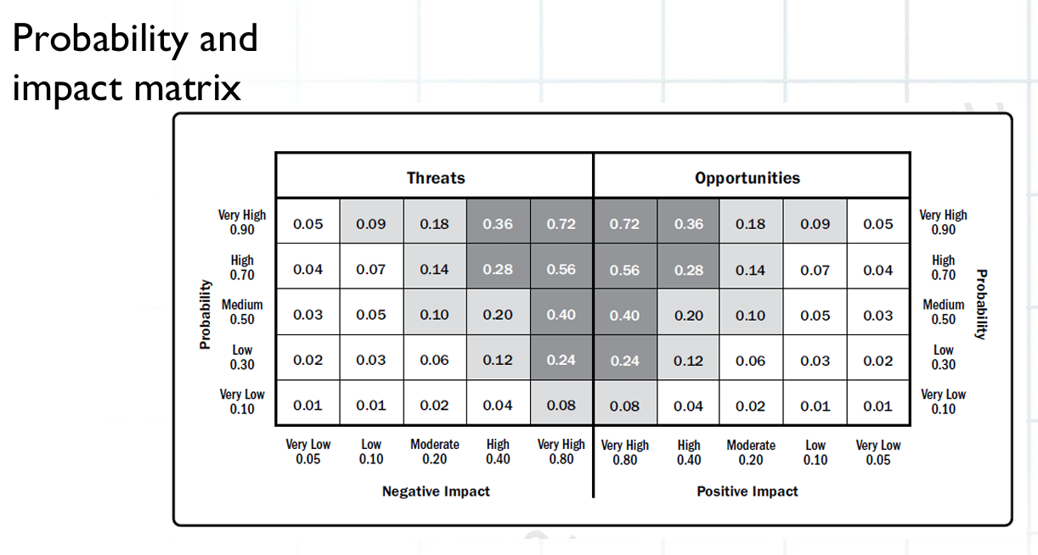
Perform Qualitative Risk Analysis

Slide 43
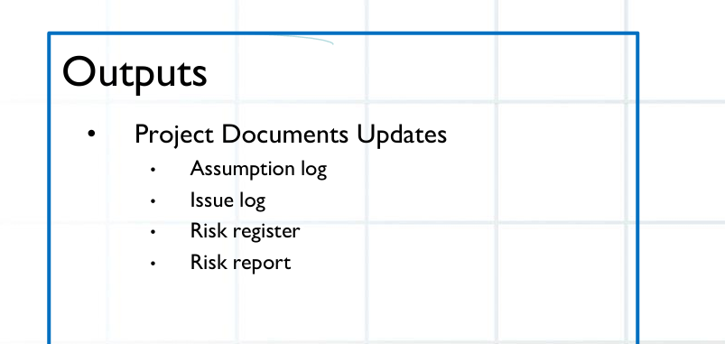
Perform Qualitative Risk Analysis

Slide 44
Steps in Qualitative Risk Analysis
Assess Probability
Determine how likely each risk is to occur.
Use scales, e.g.:
Low = <10%
Medium = 10–30%
High = >30%
Assess Impact
Determine how much the risk could affect project objectives.
Example scale: Low / Medium / High or numeric values (1–5).
Calculate Risk Rating / Score
Combine probability × impact to get a risk rating.
Helps rank risks.
Prioritize Risks
High probability & high impact → High priority
Low probability & low impact → Low priority
Focus on high and medium priority risks for response planning.
Document Findings in Risk Register
Update risk register with probability, impact, risk rating, and priority.

Slide 45
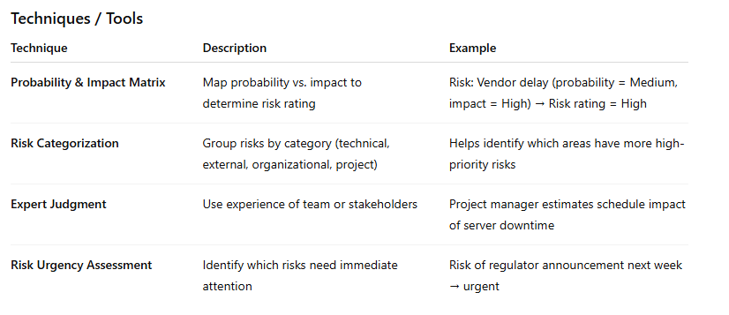
Tools used

Slide 46
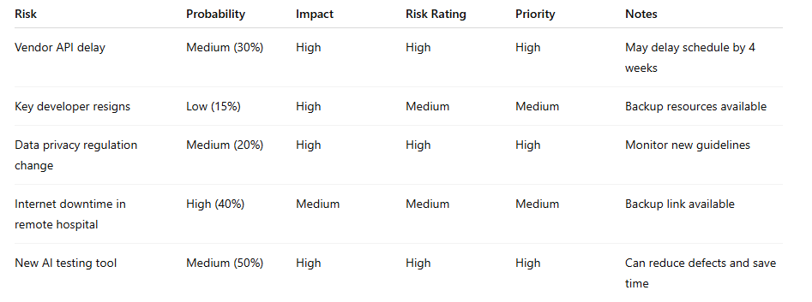
Example

Slide 47
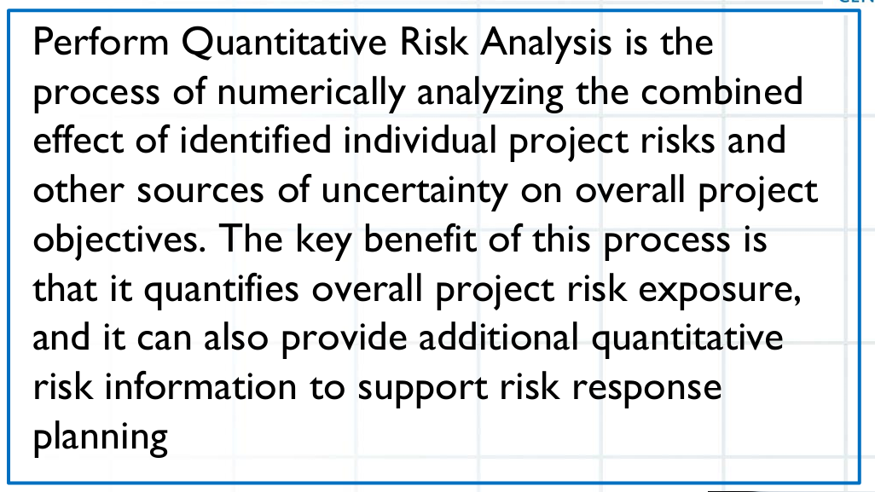
Perform Quantitative Risk Analysis
Perform Quantitative Risk Analysis is the process of numerically analyzing the effect of identified risks on project objectives (scope, schedule, cost, quality, benefits).
Purpose / Why It’s Important
Provides a numerical understanding of risks.
Helps estimate overall project uncertainty (e.g., total cost, schedule variance).
Supports decision-making for contingency reserves and risk response priorities.
Complements qualitative risk analysis, which is subjective.

Slide 48
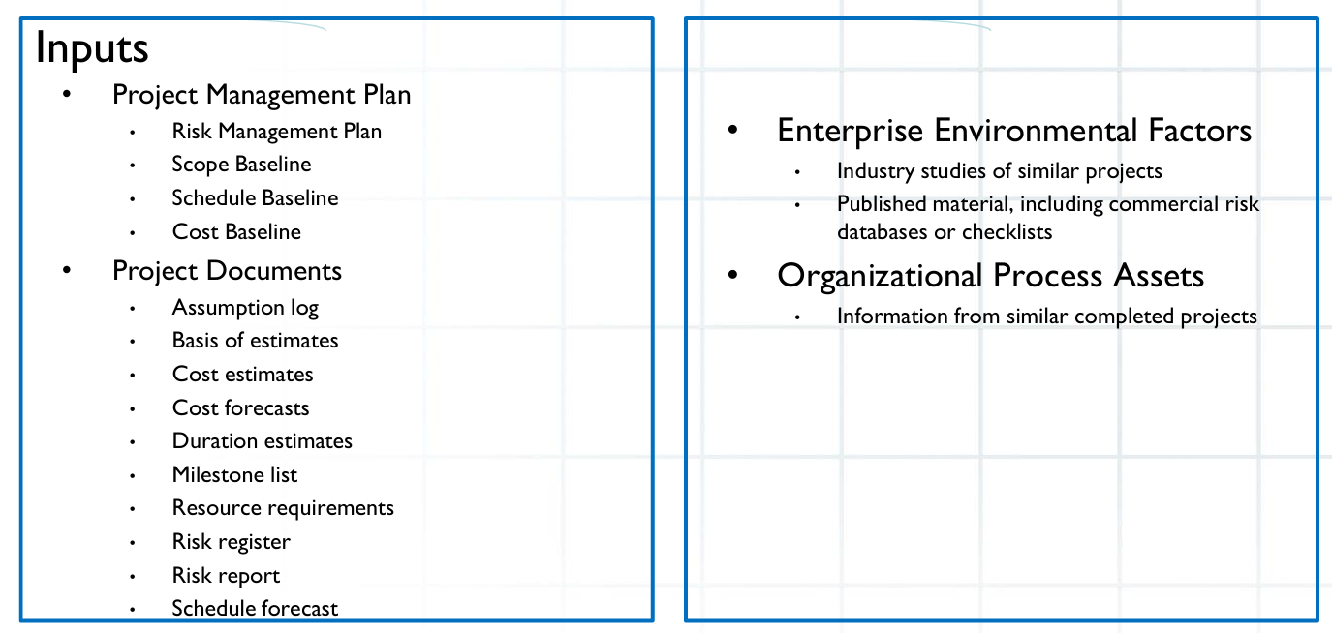
Perform Quantitative Risk Analysis

Slide 49
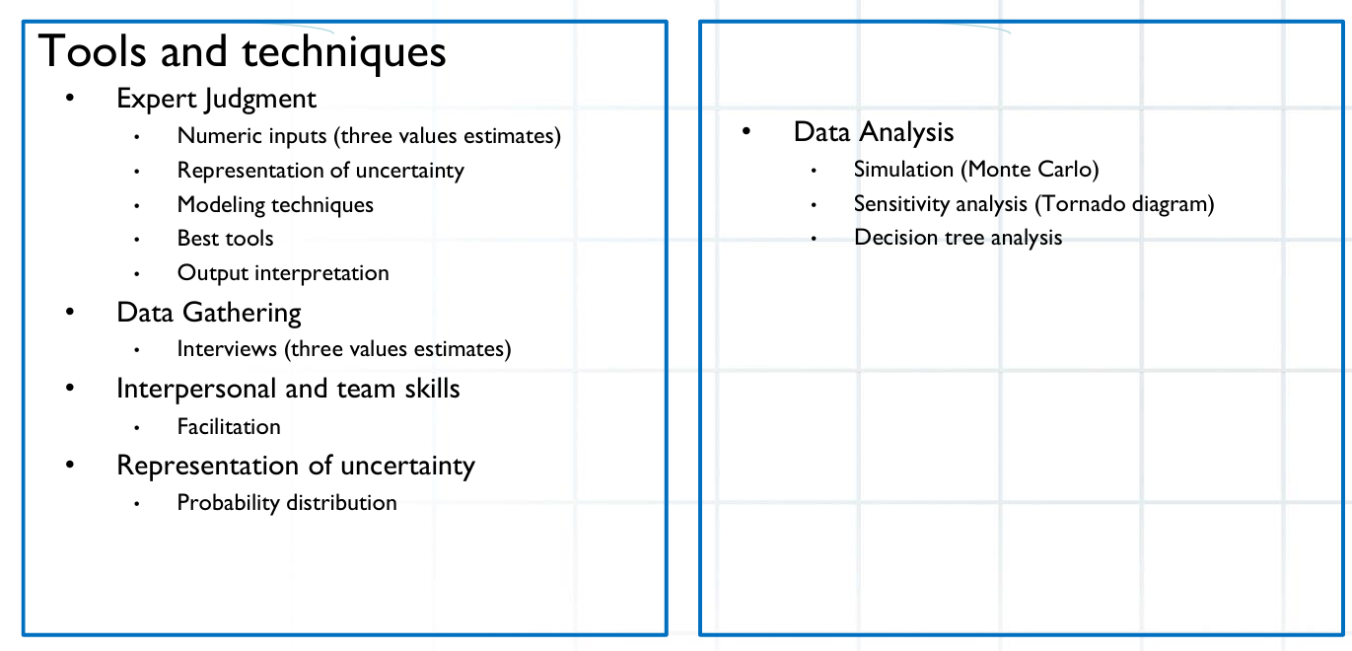
Perform Quantitative Risk Analysis

Slide 50
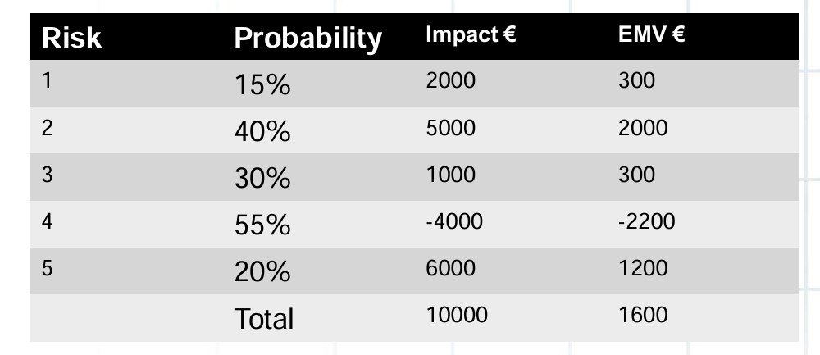
Perform Quantitative Risk Analysis

Slide 51
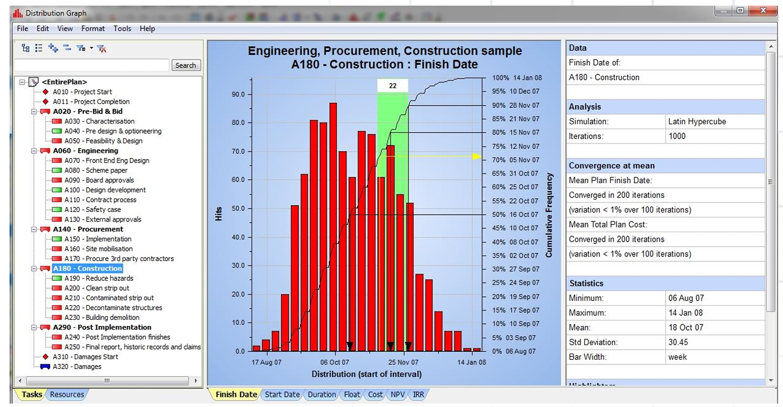
Perform Quantitative Risk Analysis

Slide 52
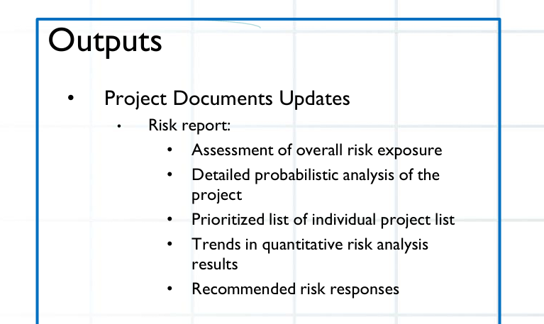
Perform Quantitative Risk Analysis

Slide 53
Steps in Quantitative Risk Analysis
Steps in Quantitative Risk Analysis
Select Risks for Quantitative Analysis
Focus on high-priority risks from qualitative analysis.
Not all risks need detailed quantitative modeling.
Assign Numeric Values to Probability & Impact
Use probability (0–1 or %) and impact (cost, schedule days, quality score).
Example: Probability 0.3 × Impact $20,000 → Expected Monetary Value (EMV).
Analyze Risk Interactions / Correlations
Some risks are dependent (e.g., vendor delay may cause testing delay).
Identify linked risks for more accurate modeling.
Apply Quantitative Techniques

Slide 54
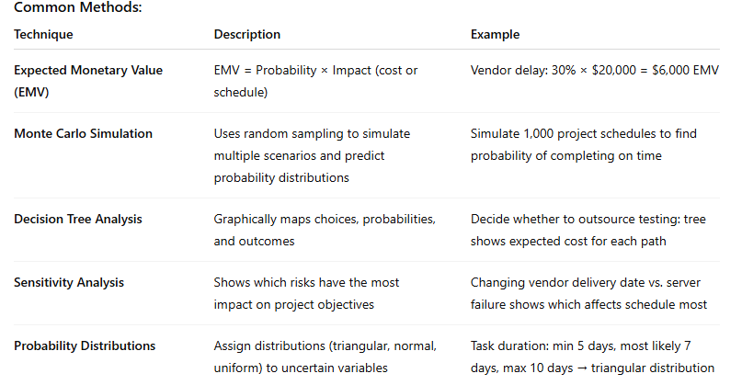
Steps in Quantitative Risk Analysis

Slide 55
Steps in Quantitative Risk Analysis
Determine Overall Project Risk Exposure
Aggregate the risk impact (cost, schedule) from all significant risks.
Helps define contingency reserves (budget or time buffers).
Document Results
Update Risk Register with EMV, probability distributions, simulations results.
Prepare Risk Report with numeric insights for stakeholders.

Slide 56
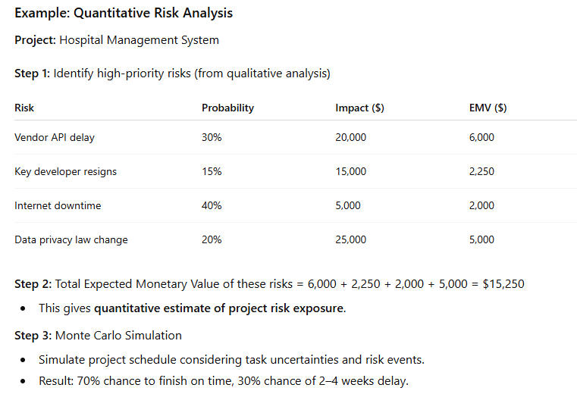
Steps in Quantitative Risk Analysis

Slide 57
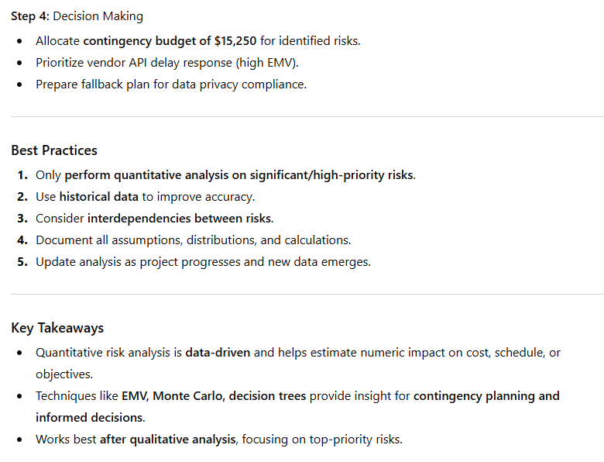
Steps in Quantitative Risk Analysis

Slide 58
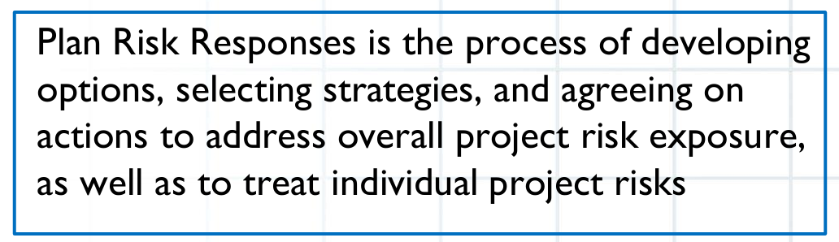
Plan Risk Responses
Plan Risk Responses is the process of developing options and actions to enhance opportunities and reduce threats to project objectives.
It is about deciding what to do about each risk identified and analyzed.
Purpose / Why It’s Important
To reduce negative impacts (threats) on project cost, schedule, quality, or scope.
To maximize positive impacts (opportunities) that can improve project success.
To assign risk owners and responsibilities for taking action.
To create a proactive approach instead of reacting to risks after they occur.

Slide 59
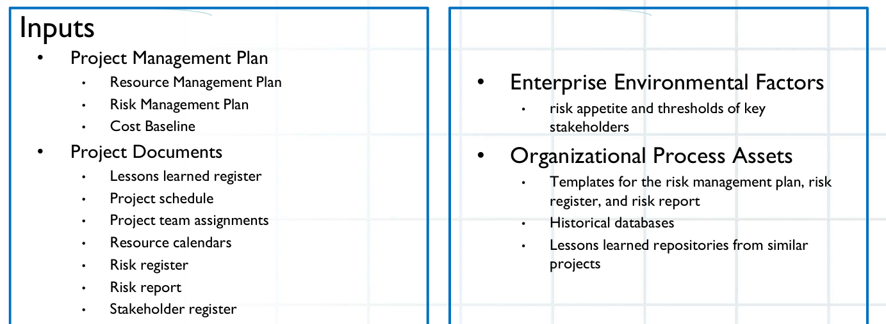
Plan Risk Responses

Slide 60
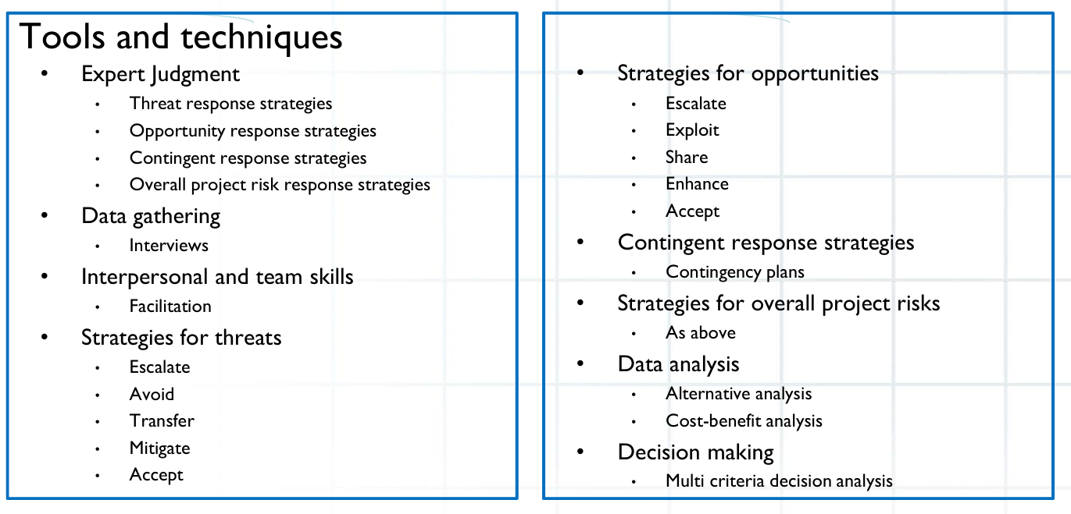
Plan Risk Responses

Slide 61
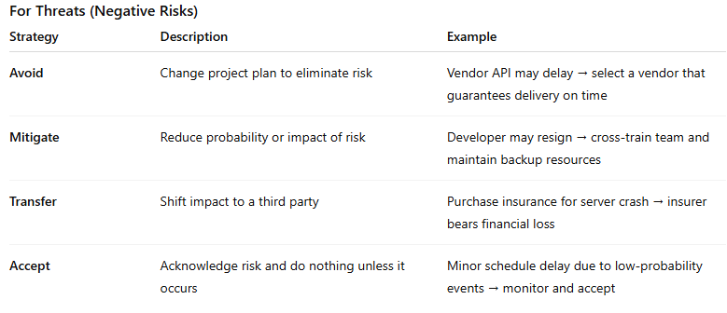
Plan Risk Responses

Slide 62
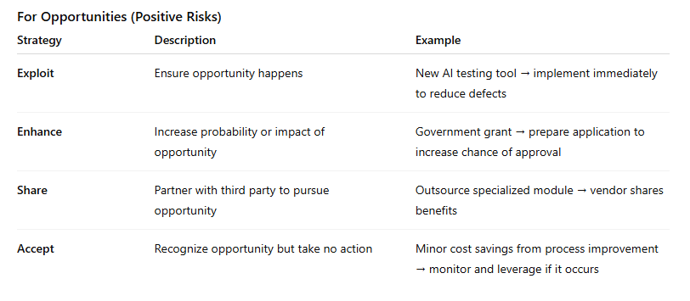
Plan Risk Responses

Slide 63
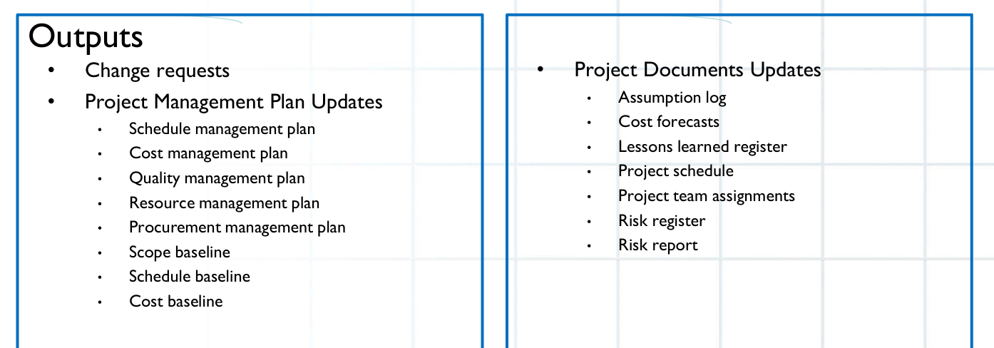
Plan Risk Responses

Slide 64
Steps in Planning Risk Responses
Review Risks
Focus on high-priority risks identified from qualitative and quantitative analysis.
Select Response Strategy
Decide threat or opportunity strategy based on impact, probability, and context.
Assign Risk Owners
Each risk must have a responsible person to implement and monitor responses.
Develop Action Plans
Define specific steps, resources, and timelines for responses.
Update Risk Register
Document selected response strategy, owner, actions, triggers, and residual risks.
Plan Contingency / Fallback Plans
For high-impact risks, prepare backup plans if the primary response fails.

Slide 65
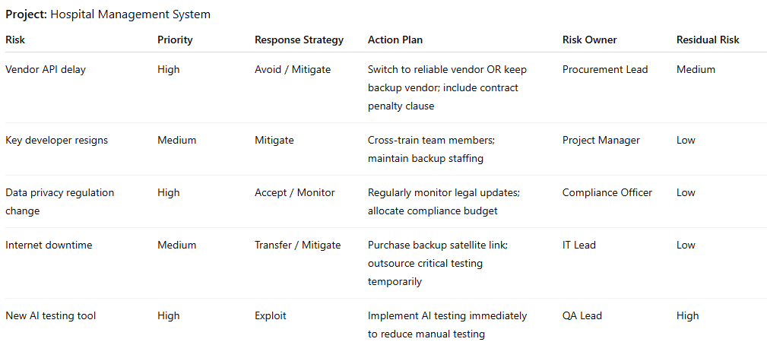
Example

Slide 66
Implement Risk Responses
Implement Risk Responses is the process of executing the planned actions to address identified risks.
This step ensures that the strategies and actions defined in Plan Risk Responses are actually carried out.
Purpose / Why It’s Important
To reduce the impact of threats (negative risks) on project objectives.
To take advantage of opportunities (positive risks) to improve project success.
To ensure that risk responses are practical, timely, and effective.
To provide documentation and accountability for all actions.

Slide 67
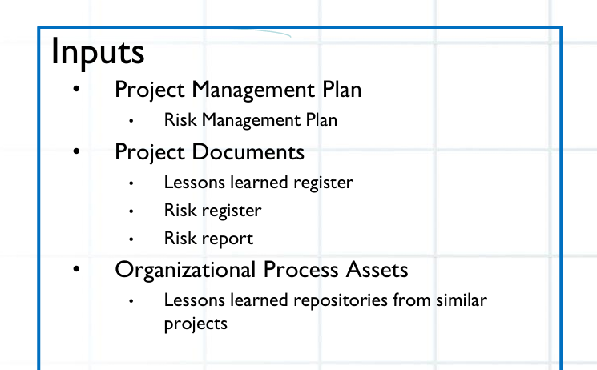
Implement Risk Responses

Slide 68
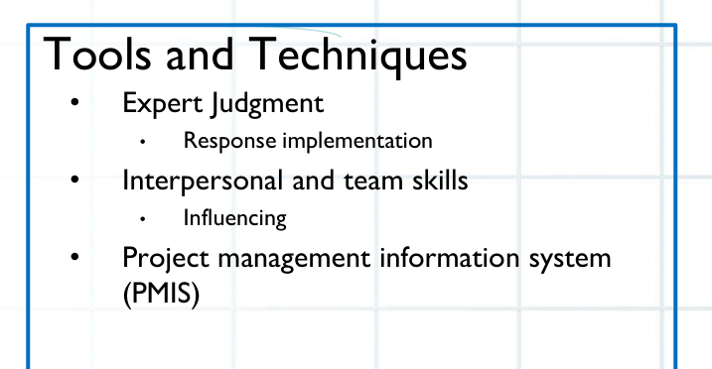
Implement Risk Responses

Slide 69
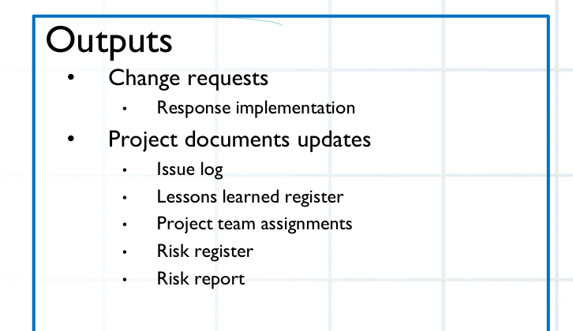
Implement Risk Responses

Slide 70
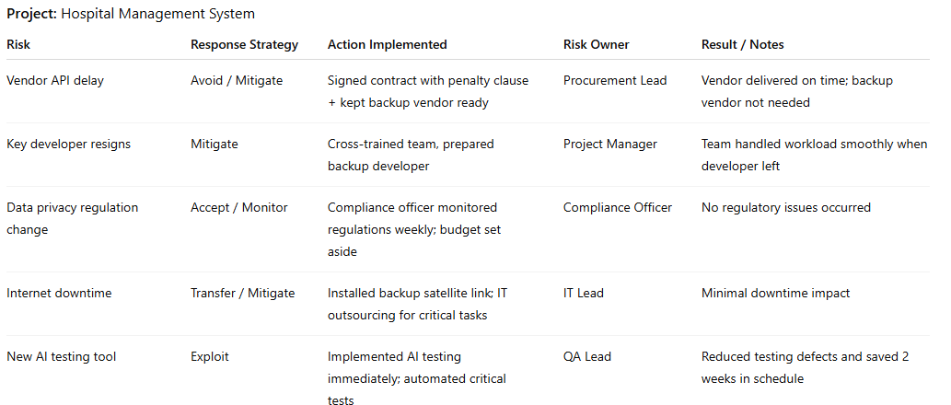
Example

Slide 71
Monitor Risks
Monitor Risks is the process of tracking identified risks, monitoring residual risks, identifying new risks, and evaluating the effectiveness of risk responses throughout the project lifecycle.
Ensures that risk management is active, continuous, and integrated with project execution
Purpose / Why It’s Important
To ensure risk responses are effective and reduce threats or exploit opportunities.
To detect new risks early before they impact the project.
To update risk documentation and inform decision-making.
To maintain stakeholder confidence by providing transparency on risk status.

Slide 72
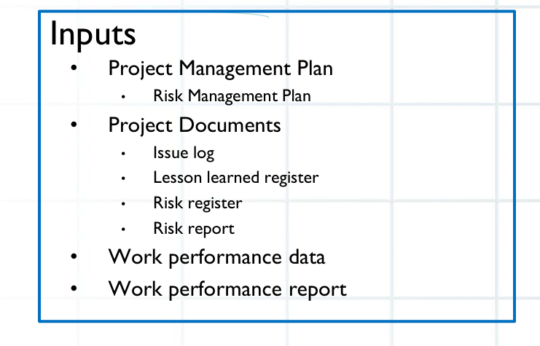
Monitor Risks

Slide 73
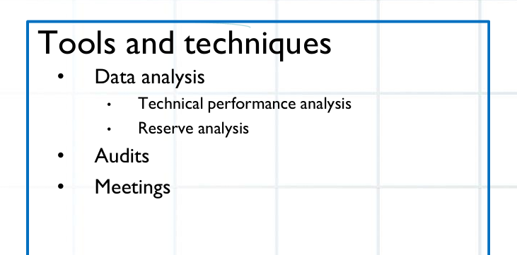
Monitor Risks

Slide 74

Monitor Risks

Slide 75
Steps in Monitor Risks
Track Identified Risks
Check if risks are occurring as expected and whether planned responses are implemented.
Monitor Residual and Secondary Risks
Residual risks: Risks that remain after response actions.
Secondary risks: New risks created as a result of risk responses.
Identify New Risks
Conduct periodic risk reviews or workshops.
Monitor internal and external changes that may introduce new risks.
Evaluate Risk Response Effectiveness
Determine if responses reduced threats or enhanced opportunities.
Adjust or implement alternative strategies if needed.
Update Risk Register & Reports
Document current risk status, changes in probability or impact, and lessons learned.

Slide 76

Steps in Monitor Risks

Slide 77

Example

Slide 78


Slide 79


Slide 80
When to Use Qualitative Risk Analysis
Use qualitative analysis when:
Project is small or simple – you don’t need detailed numbers.
Early in the project – quick prioritization of risks is needed.
Limited data is available – relies on expert judgment rather than historical data.
Time and resources are limited – faster and easier to perform.
You want to rank risks – to focus on the most critical ones first.
Example:
A small software project with 5–10 risks.
Risks like “Developer may resign” or “Vendor delivery may be late” are assessed as High, Medium, or Low to prioritize which need immediate attention.

Slide 81
When to Use Quantitative Risk Analysis
Use quantitative analysis when:
Project is large, complex, or high-value – decisions require numeric insight.
High uncertainty exists – need to measure potential cost, schedule, or performance impact.
Sufficient data is available – historical data, probability distributions, or cost/schedule estimates.
Stakeholders require numeric risk assessment – e.g., for contingency budgeting or probability of completing on time.
You need to simulate scenarios – Monte Carlo, decision trees, sensitivity analysis.
Example:
A hospital management system with multiple modules and vendors.
Risks like “Vendor API delay” or “Data privacy regulation changes” are analyzed numerically to calculate expected cost impact ($) or schedule delays (weeks).

Slide 82
Practical Rule of Thumb
Start with Qualitative Risk Analysis – rank risks, focus on high-priority ones.
Do Quantitative Risk Analysis only on high-priority risks to get numeric estimates for cost, schedule, or performance impact.
Use both together for comprehensive risk management:
Qualitative → prioritization
Quantitative → detailed decision-making

